Slide 1


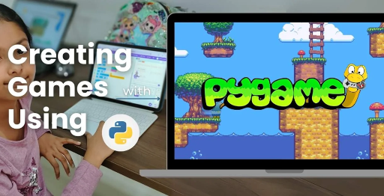
Session 8
Collision Detection & Damage System

Slide 2
Learning Objectives
Understand game inspiration, install Pygame-CE, navigate project structure
Detailed Objectives:
Objectives:
Implement rectangle-based collision detection using Pygame-CE.
Track block health and handle destructible environments.
Update game state after collisions (e.g., reduce health, remove blocks).

Slide 3
Practical Tasks
Understand game inspiration, install Pygame-CE, navigate project structure
Below is the list of Practical Tasks:
Write check_block_collisions() and check_alien_collisions() in tools.py using Pygame’s Rect collision methods.
Update Block class to reduce health via a take_damage() method.
Test by launching a bird at a structure and reducing block health on impact.
Display visual feedback (e.g., cracks on blocks) using assets from assets.py.

Slide 4
Deliverables
Understand game inspiration, install Pygame-CE, navigate project structure
Session Deliverables:
tools.py with collision detection functions.
A working damage system with visual feedback on blocks.
Tips:
Test collisions with slow-moving birds to debug issues.
Use print statements to track health changes.

Slide 5
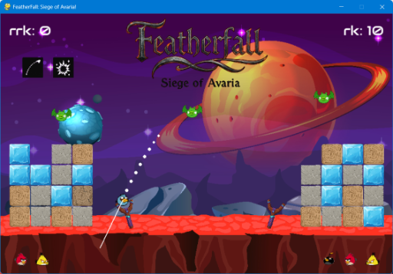
Launch Physics & Trajectory in PyGame
🧱 Collision Detection & Damage System in PyGame
👉 Training students to build destructible environments using Rect collisions in PyGame-CE

Slide 6
OMOGAME - “Detect. Damage. Destroy.”
🧱 “Detect. Damage. Destroy.”
👉 Build Realistic Collisions and Breakable Structures in OMOGAME
Introduce students to collision systems and why they matter in gameplay.
Introduce collision systems for dynamic gameplay.
Inspired by Angry Birds, players launch birds to destroy fortresses.
Focus: Detect impacts, apply damage, and update visuals.
Learn to implement collisions using Pygame-CE.
Enhances realism and engagement in two-player battles.

Slide 7
What is Collision Detection?
🧱 What is Collision Detection?
👉 Training students to build destructible environments using Rect collisions in PyGame-CE
Tracks when objects (e.g., birds, blocks, aliens) overlap or impact.
Critical for scoring hits and triggering destruction in gameplay.
Used to detect bird impacts on blocks or aliens.
Without it, birds would pass through objects with no effect.
Managed in tools.py for accurate game interactions.
Key to realistic physics in Siege of Avaria!

Slide 8
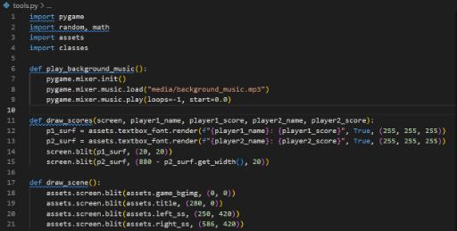
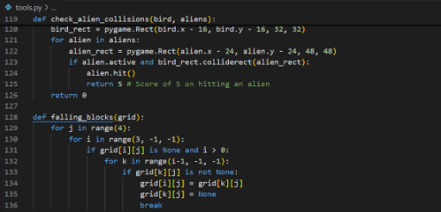
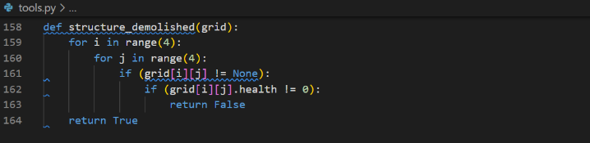
What is Collision Detection?
CODE SNIPPETs :

Slide 9
The Tools Behind Collisions
🧱 The Tools Behind Collisions
Module Function
tools.py Houses collision detection methods
classes.py Defines block health + hit response (take_damage)
assets.py Manages visuals like crack images or debris
tools.py: Houses collision detection methods (e.g., check_block_collisions).
classes.py: Defines Block class with take_damage method and health.
assets.py: Loads visuals like cracked block images or debris effects.
game_modes.py: Integrates collisions with scoring and win conditions.
media/: Stores images and sounds for collision feedback.
Collaborative modules ensure seamless damage system.

Slide 10
Writing check_block_collisions()
🧱 Writing check_block_collisions()
In tools.py:
def check_block_collisions(bird, blocks):
for block in blocks:
if bird.rect.colliderect(block.rect):
block.take_damage(bird.damage)
🎯 Uses PyGame’s Rect.colliderect() method to trigger contact
In tools.py:
def check_block_collisions(bird, blocks):
for block in blocks:
if bird.rect.colliderect(block.rect):
block.take_damage(bird.damage)
Uses Pygame’s Rect.colliderect() for collision detection.
Triggers take_damage on block when bird hits.
Supports both Quick and Basic modes.
Updates game state for scoring and destruction.

Slide 11
Adding take_damage() to Block Class
🧱 Adding take_damage() to Block Class
In classes.py:
class Block:
def take_damage(self, amount):
self.health -= amount
if self.health <= 0:
self.destroy()
📉 Block health decreases on hit → destroyed when health ≤ 0
In classes.py:
class Block:
def take_damage(self, amount):
self.health -= amount
if self.health <= 0:
self.destroy()
Reduces block health based on bird’s damage value.
Destroys block when health reaches zero.
Interacts with assets.py for visual updates.
Enables destructible environments in gameplay.

Slide 12
Visual Feedback: Show Cracks or Debris
🧱 Visual Feedback: Show Cracks or Debris
In assets.py, load damaged block variants
In tools.py, draw image based on block’s health:
if block.health < 50:
screen.blit(cracked_image, block.rect)
📌 Visual cues make the damage system visible and intuitive
In assets.py: Load damaged block variants (e.g., cracked_wood.png).
In tools.py:
if block.health < 50:
screen.blit(cracked_image, block.rect)
Updates block sprite based on health level.
Visual cues make damage intuitive for players.
Images stored in media/ for rendering.
Enhances immersion in fortress destruction.

Slide 13
Alien Collision Detection
🧱 Alien Collision Detection
Write check_alien_collisions():
Similar to block collisions
On hit, alien disappears and bonus score is awarded
Trigger animation or sound effect for feedback
In tools.py:
def check_alien_collisions(bird, aliens):
for alien in aliens:
if bird.rect.colliderect(alien.rect):
alien.destroy()
return bonus_score
Removes alien on hit and awards bonus points.
Triggers sound or animation via assets.py.
Integrated in game_modes.py for Quick Mode scoring.
Adds variety to gameplay targets.

Slide 14
Test and Debug Your System
🧱 Test and Debug Your System
🧪 Test Case:
Launch a bird → hits a stone block
Check if:
Health reduces
New sprite appears
Block eventually disappears
💬 Use print(block.health) in terminal to verify logic
Test Case:
Launch bird at a stone block.
Verify health reduces, sprite updates, and block disappears.
Use print(block.health) in tools.py to track changes.
Test in both Quick and Basic modes for consistency.
Check game_modes.py for score updates.
Ensure visuals from assets.py render correctly.

Slide 15
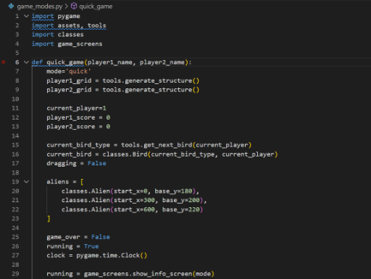
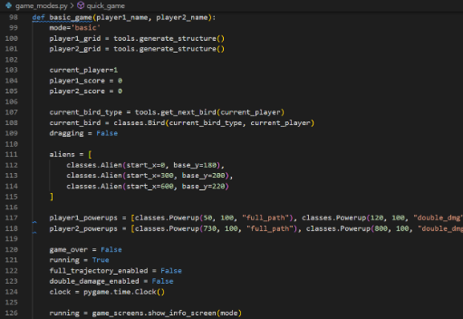
Test and Debug Your System
CODE SNIPPETs : GAME MODES

Slide 16
Student Exercise Task – Build a Damage-Test Arena
🧱 Student Task – Build a Damage-Test Arena
🛠️ Your Mission:
Set up 5 blocks of different health types
Add 1 bird and fire at angle
Log which blocks are destroyed after hit
📂 Submit: updated tools.py, classes.py, gameplay screenshot
Mission:
Set up 5 blocks with different health (e.g., wood: 50, stone: 100).
Launch one bird at an angle to hit blocks.
Log which blocks are destroyed in console.
Deliverables: Updated tools.py, classes.py, gameplay screenshot.
Save as: my_damage_arena.py.
Submit for feedback on collision accuracy.

Slide 17
Recap – From Code to Chaos
🧱 Recap – From Code to Chaos
✅ You now know how to:
Detect collisions using Rect
Damage blocks with precision
Change visuals based on health
💡 Tip: Try using explosions or particles for advanced feedback later!
What you learned:
Detect collisions using Pygame’s Rect.colliderect.
Apply damage with take_damage in classes.py.
Update visuals based on health via assets.py.
Integrate collisions with scoring in game_modes.py.
Design tip: Add explosion or particle effects for advanced feedback.
Reference: Pygame CE Documentation (https://pyga.me/docs/).

Slide 18

Exercise:
1. What is the primary objective of the Quick Mode in OMOGAME?
A) Collect all power-ups before the opponent
B) Launch birds without any destruction
C) Reach a score of 200 points
D) Complete the entire storyline
Answer: C) Reach a score of 200 points
2. Which file is considered the main entry point of the OMOGAME project? A) tools.py
B) main.py
C) assets.py
D) classes.py
Answer: B) main.py

Slide 19
Exercise..
3. What does the tools.py file mainly handle in the game?
A) Launching sound and animation
B) Player avatar selection
C) Collision detection and drawing functions
D) Managing game instructions
Answer: C) Collision detection and drawing functions
4. Which of the following is NOT listed as a unique feature of OMOGAME? A) Bird classes with special physics
B) Alien targets for bonus points
C) Multiplayer online matchmaking
D) Destructible block environments
Answer: C) Multiplayer online matchmaking

Slide 20
Exercise…
5. Why is organizing the OMOGAME project into files like classes.py, media/, and game_modes.py important?
A) It reduces the game’s memory usage
B) It helps reduce the number of bugs completely
C) It makes the project look colorful
D) It simplifies managing and updating different game parts
Answer: D) It simplifies managing and updating different game parts

Slide 21
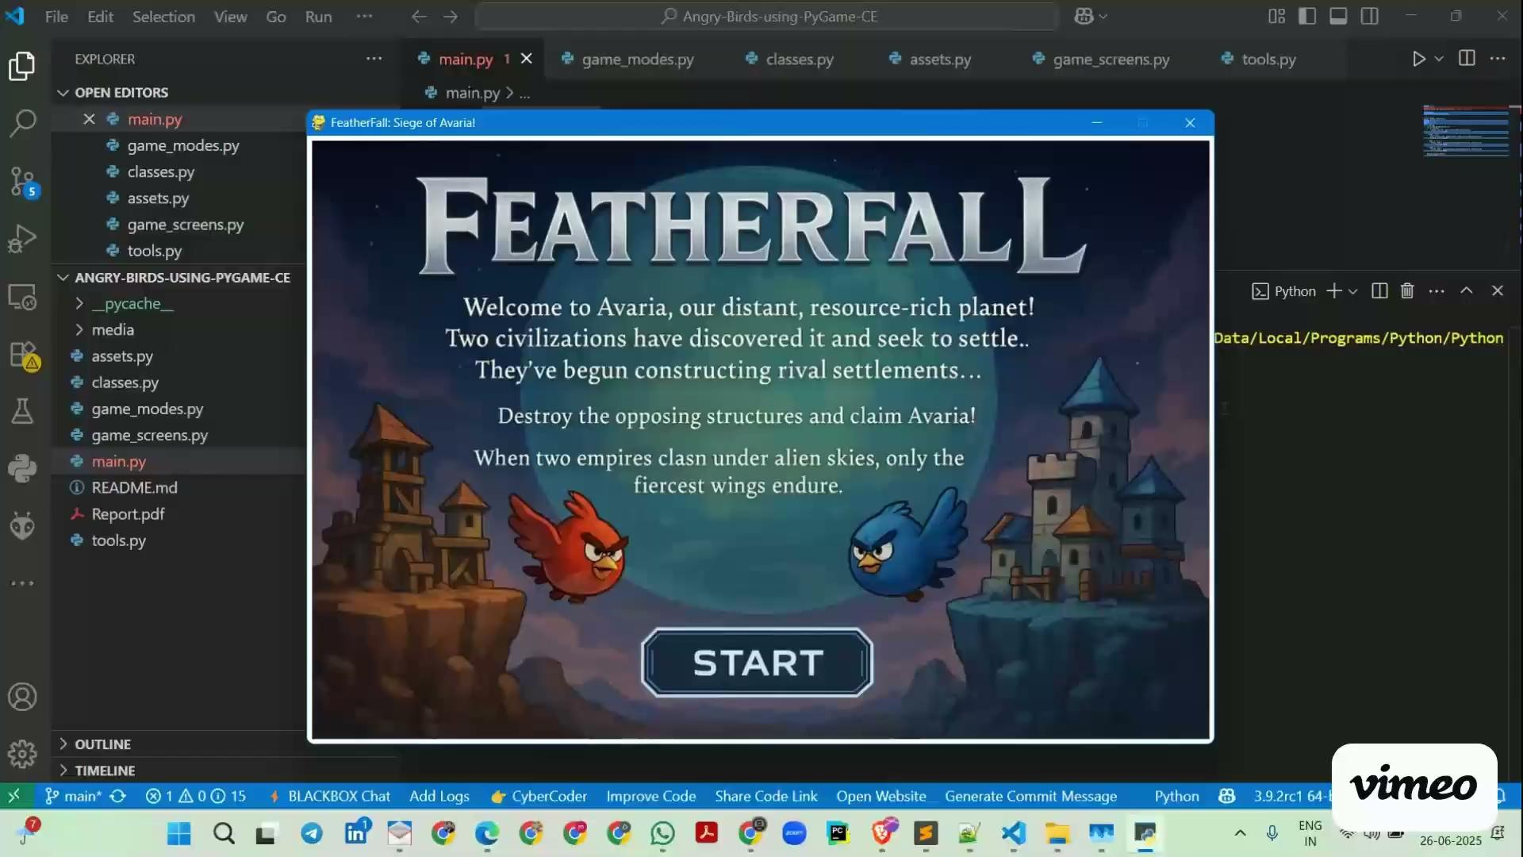
Session 8 VIDEO LINK
Collision Detection & Damage System

